Slide 1
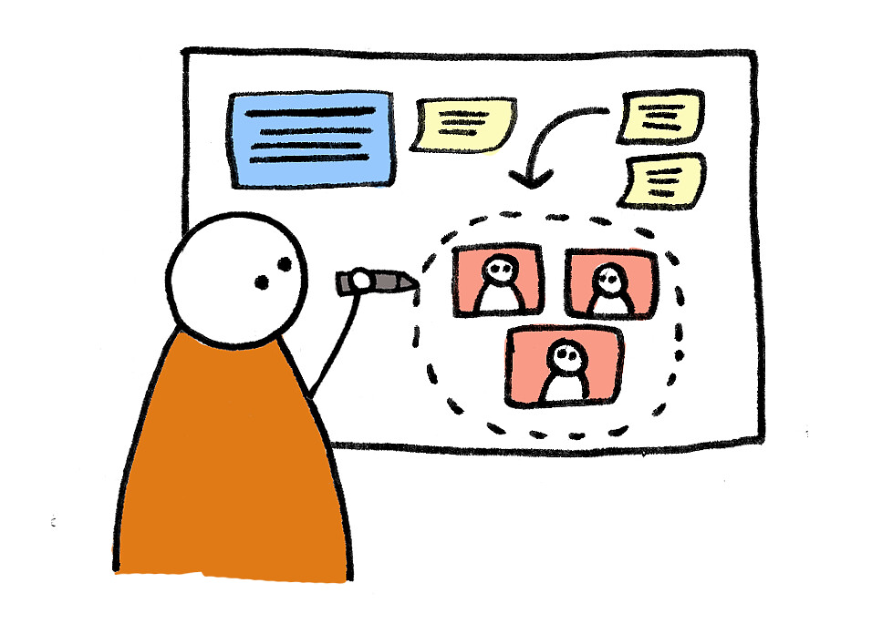
Design Thinking and the UX Design Process
Facilitated by: Jeffrey Basoah and Zak Ali

Slide 2
Agenda
Warm Up Exercise
What is Design Thinking?
Design Thinking Exercise
What is UX Design Process?
UX Design Activity
Q&A
Closing

Slide 3
Draw a flower vase

Slide 4
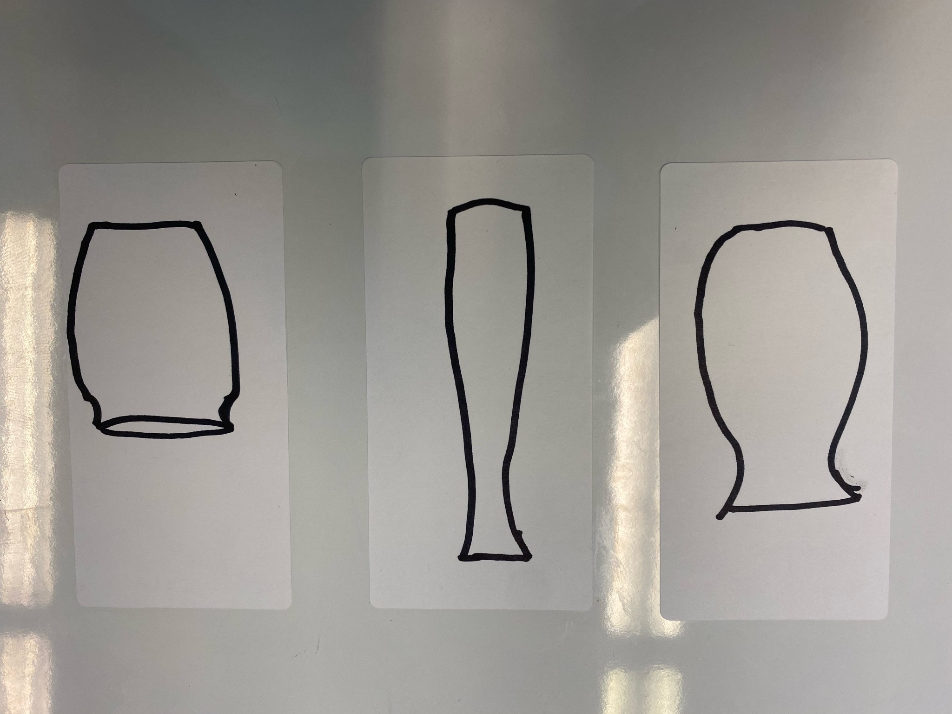

Slide 5
Design a better way for people to enjoy flowers in their homes

Slide 6
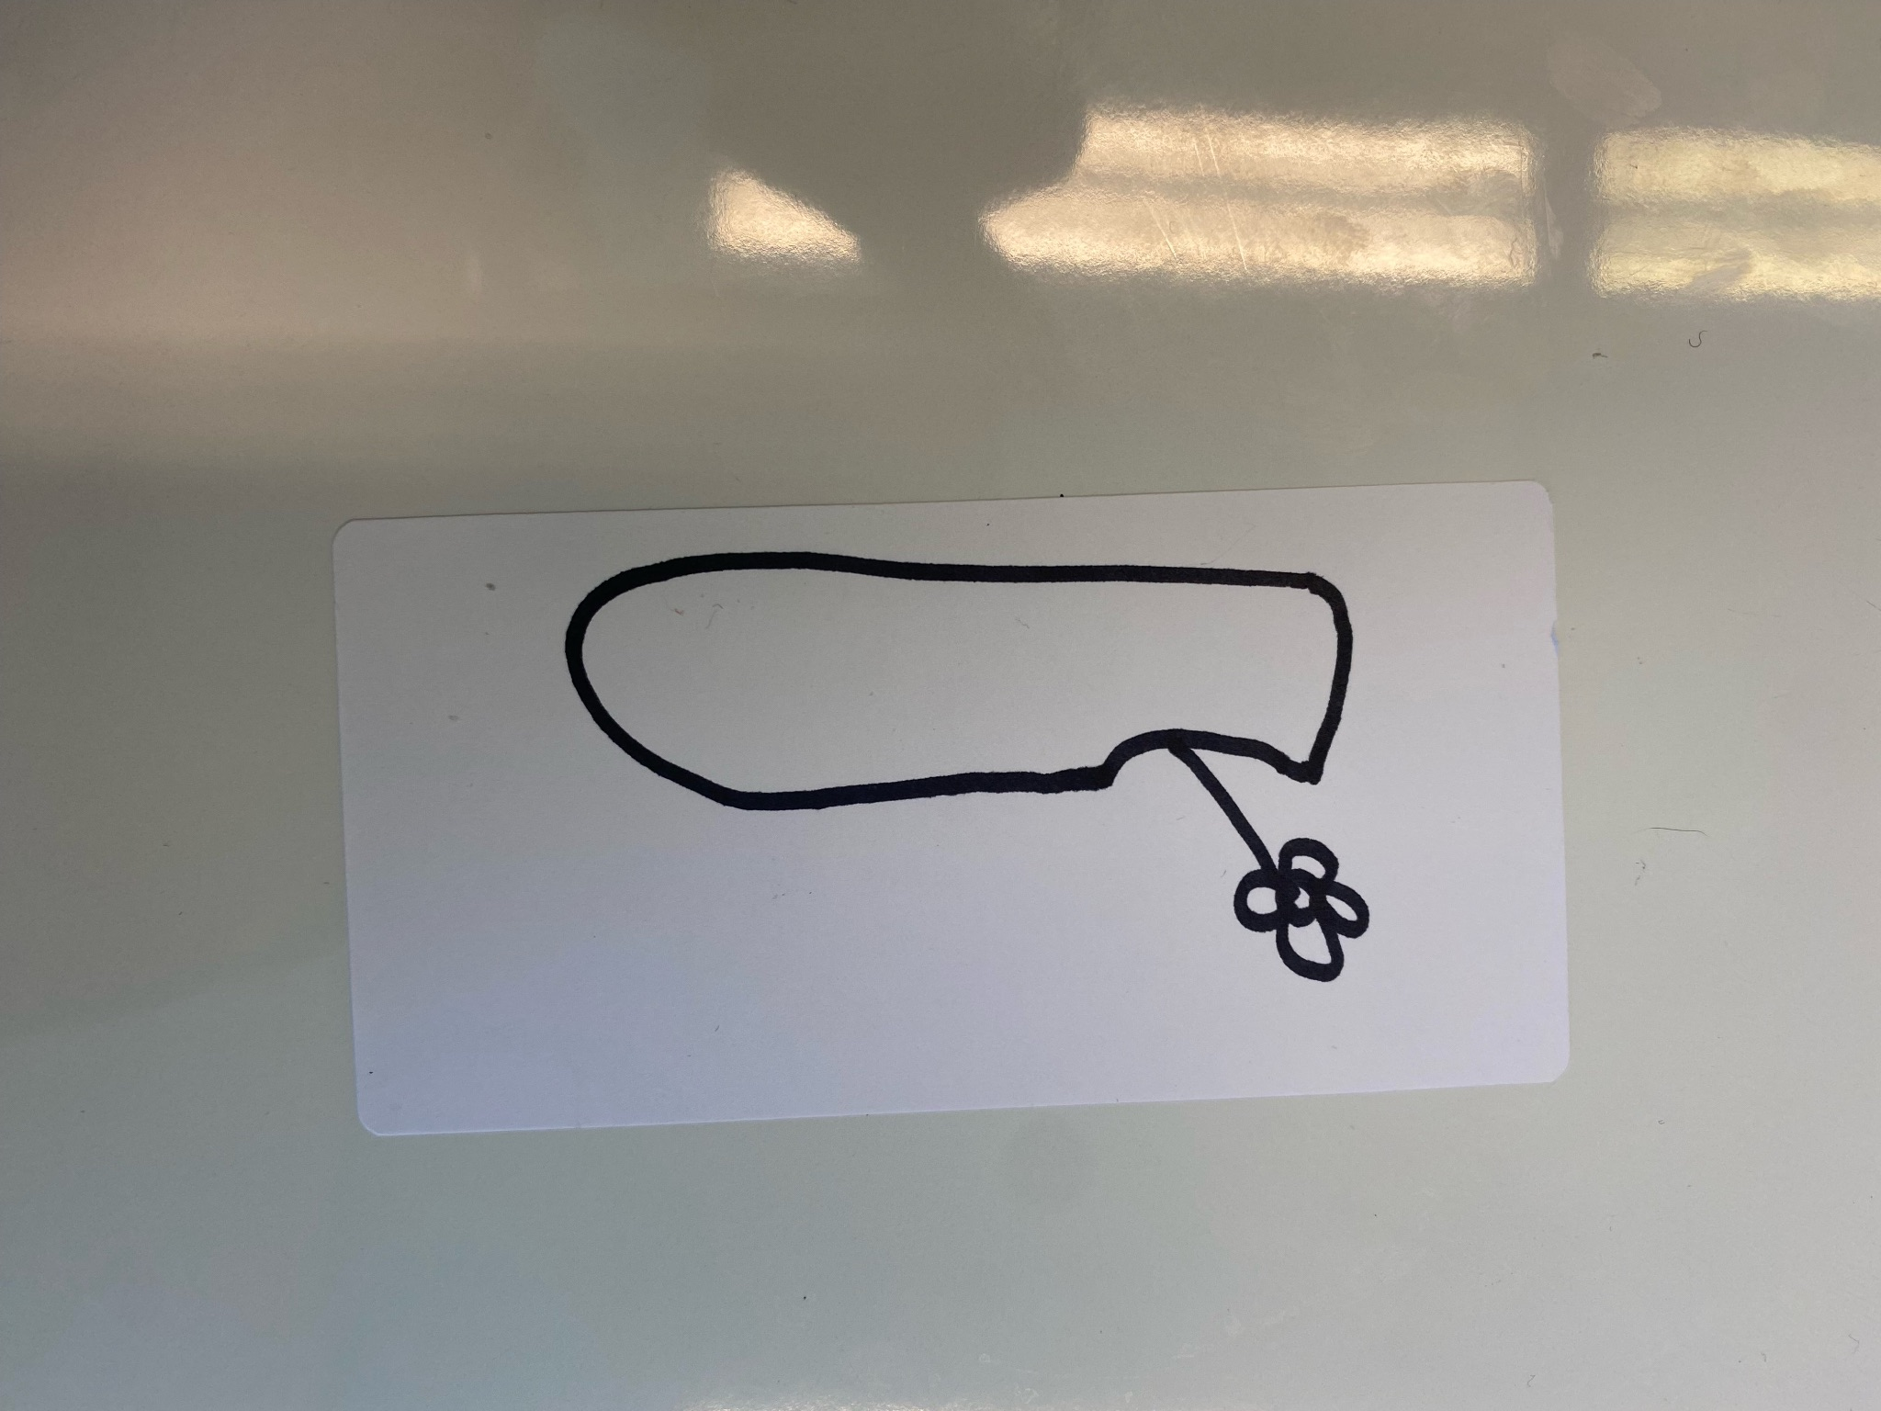

Slide 7
So what is “Design Thinking”?

Slide 8
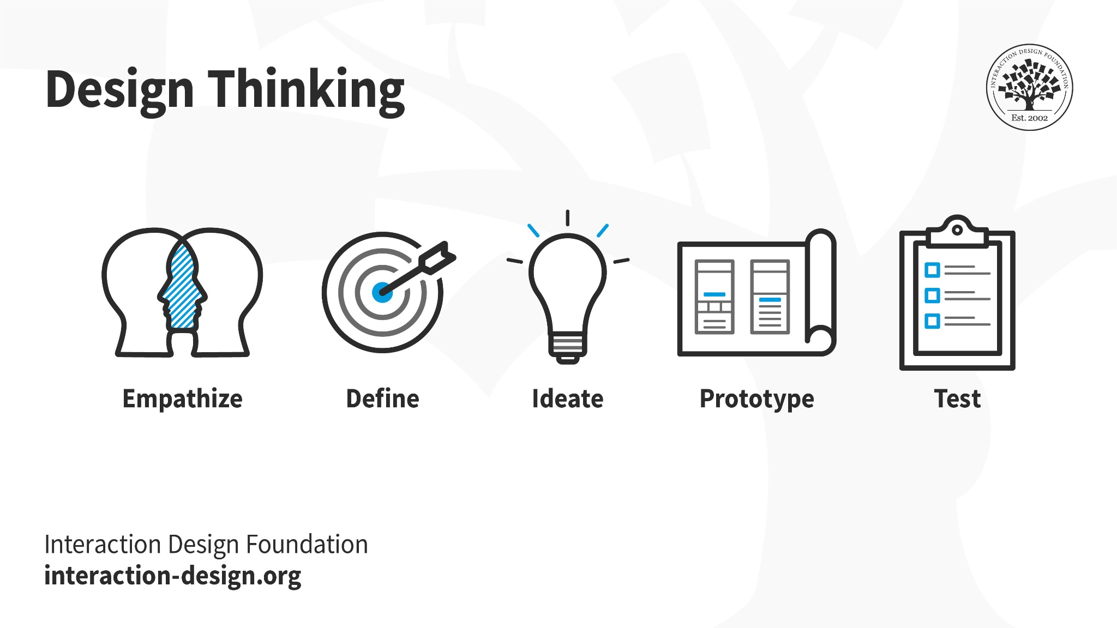
Design Thinking
Notes:
Design thinking is a problem-solving methodology that is often used in the user experience (UX) design process. It is a human-centered approach that focuses on understanding the needs and behaviors of users, and it encourages designers to think creatively and iteratively to develop innovative solutions to complex problems.
Design thinking typically involves the following stages:
Design thinking can be applied throughout the entire UX design process, from understanding the needs of users to testing the final product. It encourages designers to focus on the user and to iterate their designs based on feedback and testing, leading to a better user experience. By using design thinking in the UX design process, designers can create products that are not only functional and visually appealing but also meet the needs of their users.

Slide 9
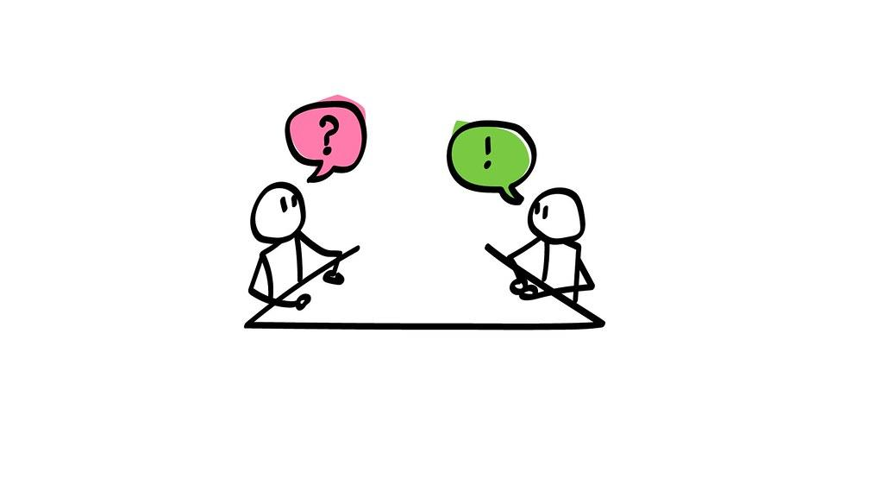

Empathize
User Interviews
Surveys
Notes:
Empathize: This stage involves understanding the needs and behaviors of users through research, user interviews, and observation.

Slide 10

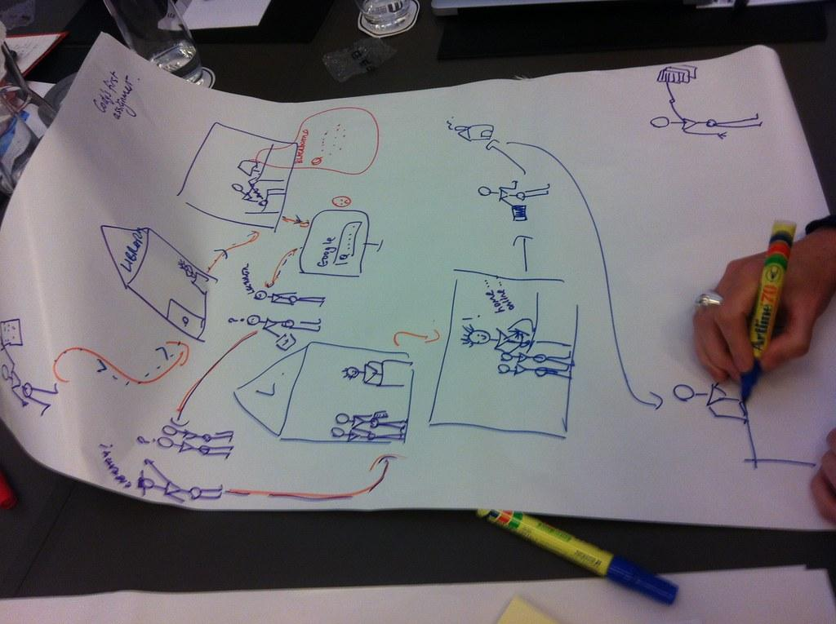
Define
Personas
Journey Maps
Notes:
Define: In this stage, designers use the information gathered in the empathy stage to define the problem they are trying to solve and create user personas, user scenarios, and user journey maps.

Slide 11
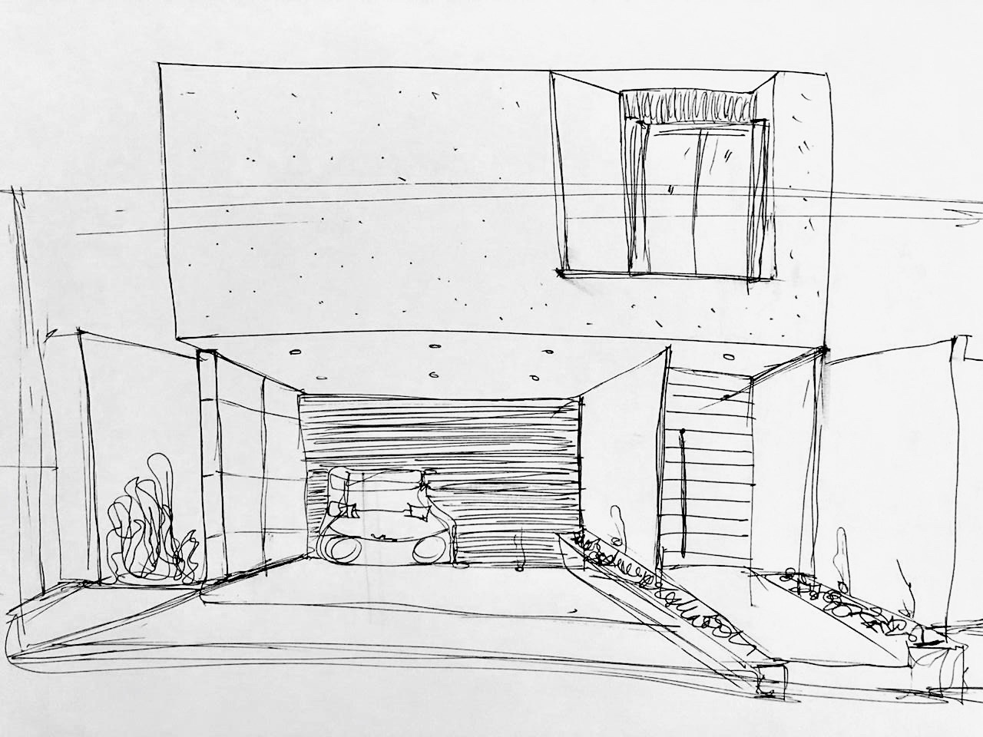
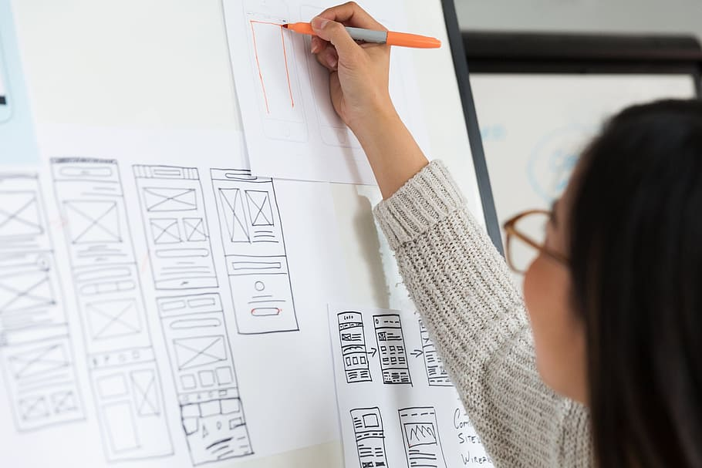
Ideate
Sketching
Wireframing
Notes:
Ideate: In this stage, designers brainstorm ideas and develop concepts for the product. This stage often involves sketching, wireframing, and prototyping.

Slide 12

Prototype
Prototype
Notes:
Prototype: In this stage, designers create a low-fidelity or high-fidelity prototype of the product to test with users and gather feedback.

Slide 13
Test
Test
Notes:
Test: In this stage, designers test the product with users to identify any issues or problems that need to be addressed. This stage often involves usability testing and A/B testing.
Design thinking can be applied throughout the entire UX design process, from understanding the needs of users to testing the final product. It encourages designers to focus on the user and to iterate their designs based on feedback and testing, leading to a better user experience. By using design thinking in the UX design process, designers can create products that are not only functional and visually appealing but also meet the needs of their users.

Slide 14
Questions?

Slide 15
Break time!

Slide 16
Let’s try it!

Slide 17
Design the worst way to turn down you volume on your computer
Notes:
https://uxdesign.cc/the-worst-volume-control-ui-in-the-world-60713dc86950

Slide 18
Let’s try it!

Slide 19
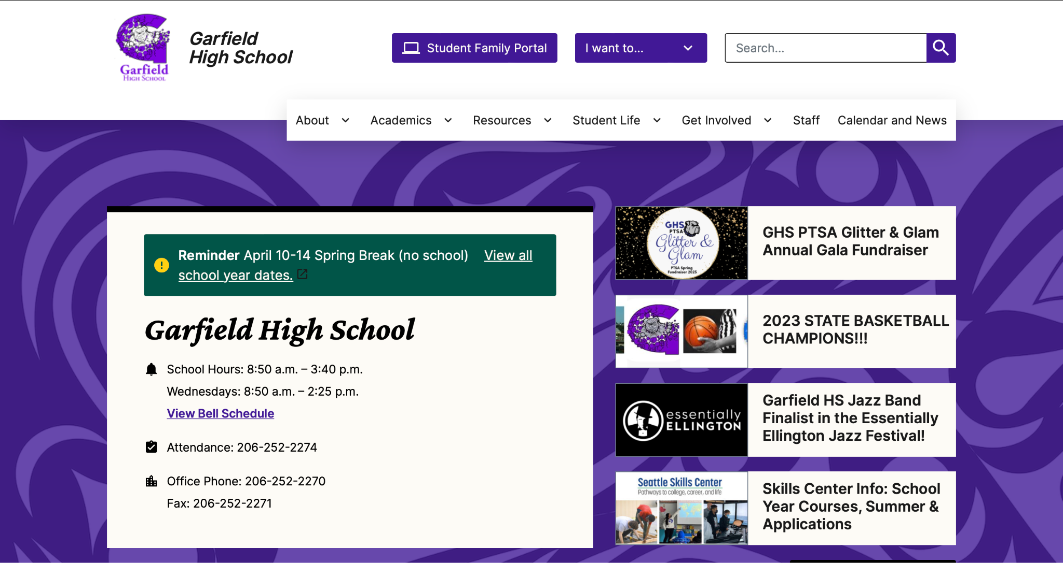

Slide 20
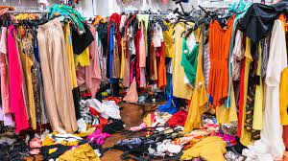
My closet is a MESS!
Notes:
Could replace “Frequently Asked Questions” with “Common Misconceptions”

Slide 21
What is the UX Design Process?

Slide 22
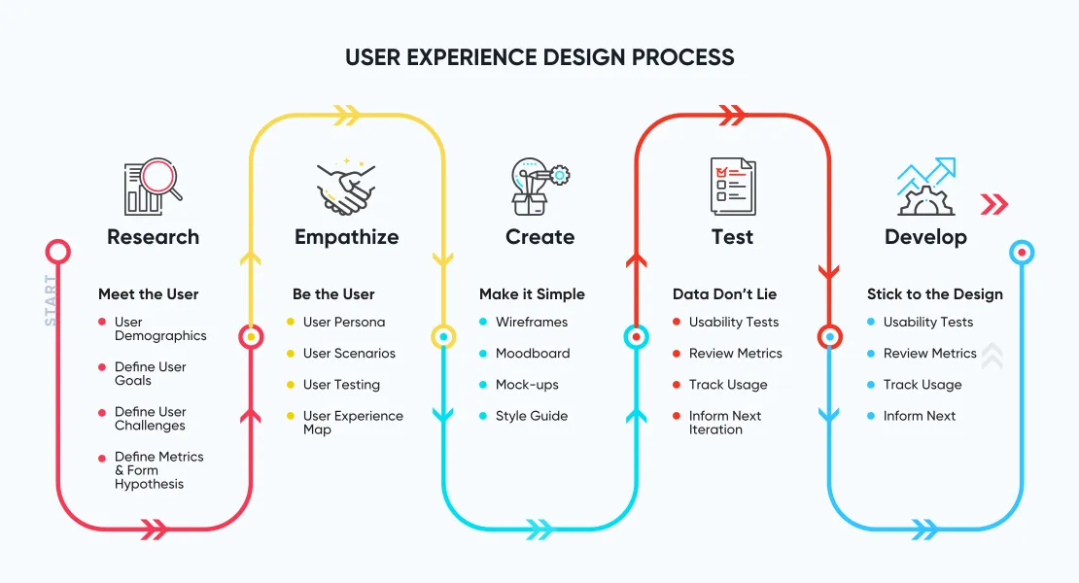
The User Experience Design Process

Slide 23
Questions?

Slide 24
Important Things to Know
Frequently Asked Questions
Common Misconceptions
Question 1
Question 2
Question 3
Question 4
Question 5
Misconception 1
Misconception 2
Misconception 3
Misconception 4
Misconception 5

Slide 25
Prominent Figures in …
Person’s name
← Image goes there
Mini bio, information about the person and their accomplishments
Person’s name
← Image goes there
Mini bio, information about the person and their accomplishments

Slide 26
What the slide is about

Slide 27
Jeopardy!
Topic of Round OR Instructions OR Any Relevant Information

Slide 28
Kahoot!
Topic OR Question

Slide 29
Let’s do a poll!
Write the question OR instructions OR relevant information here with the graphic to the left

Slide 30
Question Time!
This slide is intended for when you are asking questions with an immediate response, rather than a poll type of question like "by show of hands, how many people have heard of..." or "Who knows what...is?"

Slide 31
Prominent Figures in …
Person’s name
← Image goes there
Mini bio, information about the person and their accomplishments
Person’s name
← Image goes there
Mini bio, information about the person and their accomplishments

Slide 32
Q&A Time!

Slide 33
Q&A Time

Slide 34
Resources/Tools/Habits/Etc
Resource/Tool/Habit/Etc. 1
Resource/Tool/Habit/Etc. 2
Resource/Tool/Habit/Etc. 3
Resource/Tool/Habit/Etc. 4
Resource/Tool/Habit/Etc. 5
Pictures can be logos, screenshots, examples, etc

Slide 35
Name of concept/activity
Step 1 Instructions
Step 2 Instructions
Step 3 Instructions
Step 4 Instructions
Step 5 Instructions

Slide 36
Name of concept/activity
Step 1 Instructions
Step 2 Instructions
Step 3 Instructions
Step 4 Instructions

Slide 37
Name of concept

Slide 38
Name of concept

Slide 42
Let’s take a poll!
Write question here
Write directions here

Slide 43
Write a thank you message
Contact information
Next Steps

Slide 44
Write a thank you message
Contact AVELA if you have questions:
avelauw@uw.edu
Next Steps:
La la la

